Slide 1


Slide 2
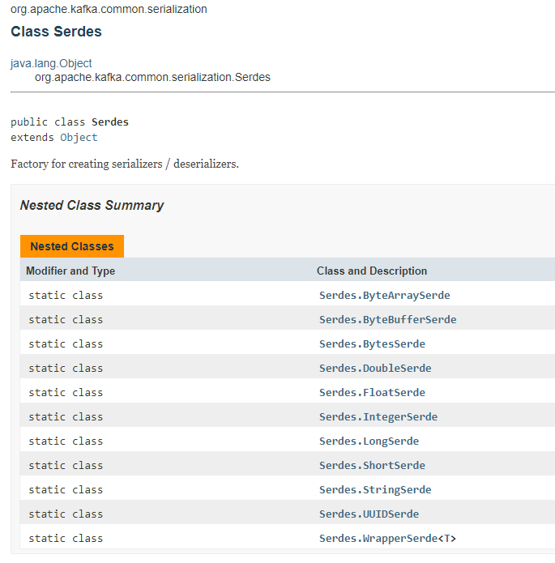
Kafka SerDes
Serializer
Deserializer

Slide 3



Creating Custom SerDes
1. Write a serializer
2. Write a deserializer
3. Write a Serde

Slide 4

Creating Custom SerDes
3. Write a Serde
class AppSerdes extends Serdes

